Slide 1
CMCS POE
Student name: Kuan-Chi Fang
Student number: St10041814

Slide 2
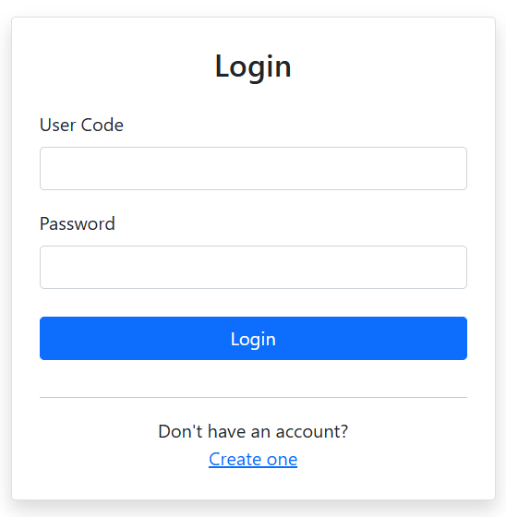
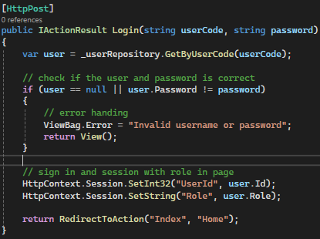
Login form
Login form, explain purpose:
The login form will check the User Code which is the login name of the user and the password.
The create one button in the login view will direct to the register view in the view of account for next steps.
Code, key explain
Firstly, the user code will compare if the user code is exist in the database, then compare the password, if both password and user code are matched then the system will place the user’s ID and his role in the session. Which the other form such as Claim view will depend on the user role and limit their controls.
The bottom code of return to the RedirectToAction is going to home page of index, and home page will lead to different view as the first page for different role user.

Slide 3
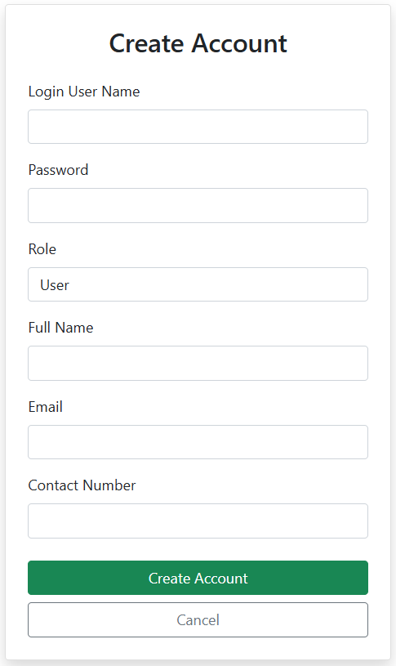
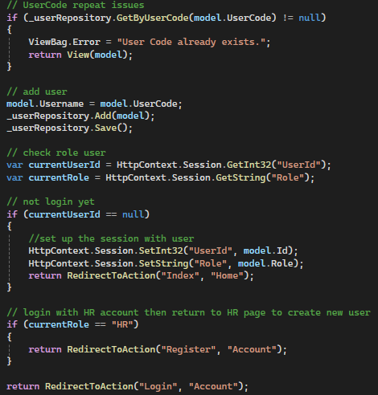
Register Form
Form Explain: The register form require user input their login name(user code) password, select role of “user”, ”Lecturer”, “Coordinator”, and “Manager”, where the “HR” were building and cannot register as a new user, then the full name, email and phone number. Then create account to continue as the session user after create, and the cancel button will return to the login page. If the user sign in as the “HR” then the cancel button will return to the index of HR page and create page will stay the same page to allows HR create another user.
Code, Key explanation: in the code the system will match the user in the database, if the user code been used then stop user to create the new user and return to the register page. Once the user code is new then the user will save in the database as “_userRepository.Save();”. After adding the user, if the session of current user is null, then sign in the adding user as the current user and direct to the page depend on the role of the user is; if the current user is “HR” as create the user, then refresh the register page to allows the HR create another user. Then while any issues happens that fail to load the current user’s page then return to the login page, but this will never happen unless the user is not user, lecturer, coordinator, manager or HR.

Slide 4
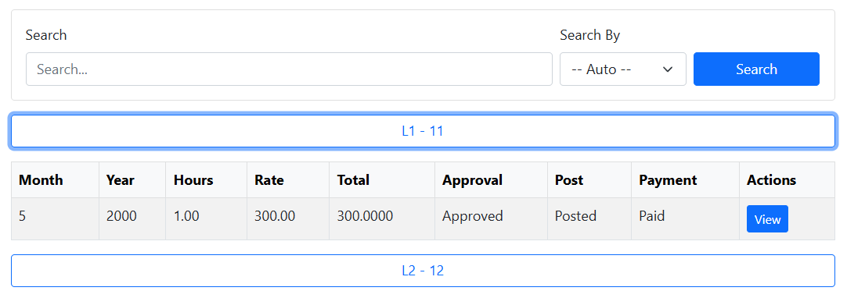
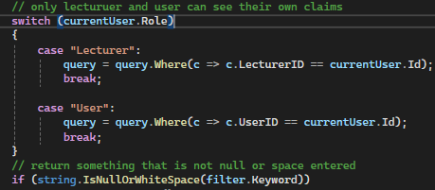
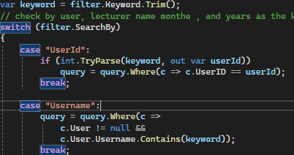
Claim Index - Search
Form Explanation: the search bar where allows user to type the key work and click the search blue button to find the relation claim for user, the search by drop down menu allows user to filter by the username(lecturer and student’s name) , month, and years of the claims. If the user is student(user) as the role, then the result will shows the button title of lecturer’s name and ID shows the related claim, the lecturer will do the student’s name and the their ID with shared claims, but coordinator, manager and HR will see the claims that sort by the lecturer name and ID.
Code explanation: the Searching bar will switch the case when the role is lecturer and user, if the user is lecturer, then the claim will only shows the claims that related to this lecturer, and the user will shows the related claim that including this user. After set up the query rules of what kind of claims must show, the filter will search the claims by the key words that type in the system(in search bar) and the default of case where set shows all the claims without rules (all claims).

Slide 5
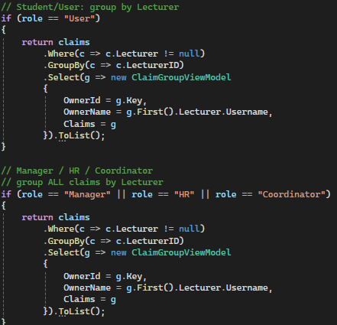
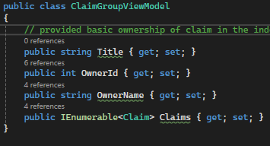
Claim Index – Claims button
Button Explanation: when the user click on the button that shows lecturer name and id (“Lecturer name – Lecturer ID” button) the drop down menu will shows the shared claim with min details start of the month and years started, hour the class, the hour rate, and the payment for total, then the state of approval, paid, and if the claims were post, while for the user(student) interface, the claims will only shows the claim that HR or manager has post and able to mark paid. When user click on the action details, it will lead the user to the details page that user selected.
Code explanation: the controller will first check the user’s role, then decided what format the claim must represent, when the user is student, then the user will get the button of owner name of lecturer name with id in ClaimGroupViewModel as the title, then the Ienumberable claim will present all the claims that shared both lecturer and the user(student). The lecturer were opposite from the user(student) the title will shows the user(student) name with the id.
If the user where coordinator, manager and HR, then the system will sort the claim by lecturer name with id, but the different from the user is super user can view all the claims title with the lecture name and id.
And the code “were(c => c.lecturer != null)” as the example, this code is the purpose of showing the lecturer name and id as the button if the lecturer has at least one claim.

Slide 6
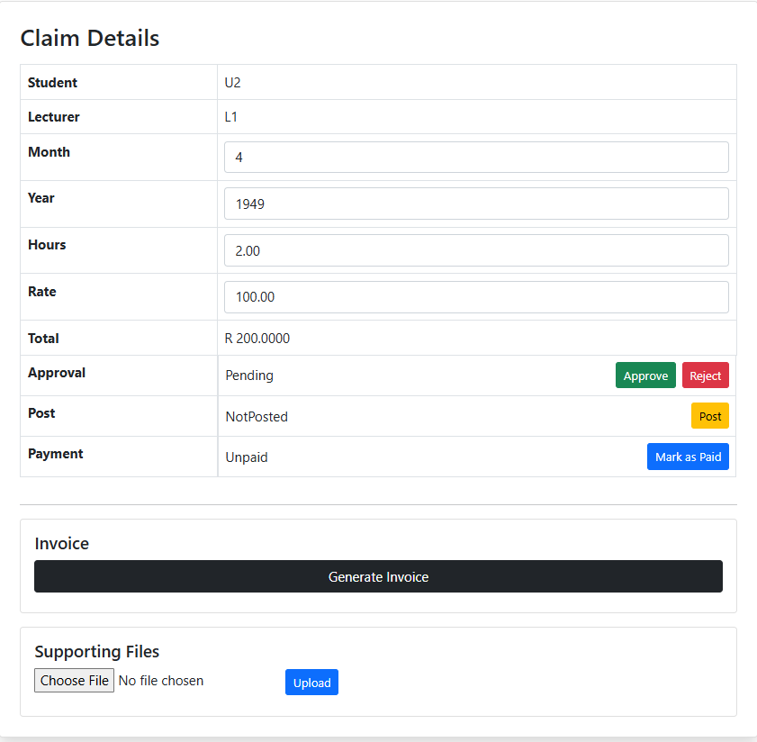
Claim Details
Form description: The details allows user to review the claims with student name, lecturer’s name, month and years of class start, hour for duration, rate for the price per hour, and total amount for the everything. Where coordinator can do edit of month, years, hours and rates, then approval or reject it. Then the manager can do post and generate the pdf invoice, user(student) can mark the payment as mark as paid, and lecturer can upload files or delete the files, while the user can download it. However the HR can edit the information, set approval post, mark paid, generate invoice and upload files. Once the manager or HR post the claim the student will see the claim in the index of their pages.

Slide 7
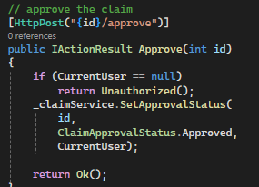
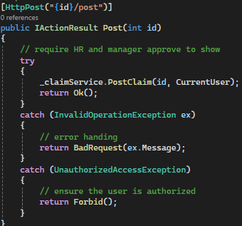
Claim details-Code explain – part 1
The details of claim use the api controller to do edit of the claim, where in this api controller, it including the approve, reject, post, and pay.
The controller is waiting for the api call , then the api call the server to do the logic, after all the server save the data though the repositories.
In the program, the approve, reject and payment where almost the same, but the different is giving the different value of status. So first check the authentic user to continue action then set the new value in the server where server save the data in the database though the repository
The post require error handing by try methods, because the post has many pre rules before post, such as the student cannot see before post, and after post the claim must be lock and not able to edit anymore. Therefore the try and catch methods is more suitable in this case. And if any issues appears, the return should shows the messages for debugging.

Slide 8
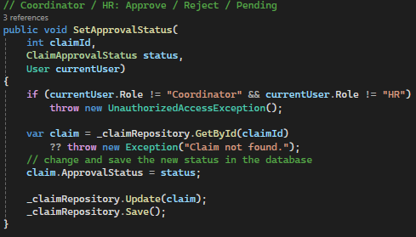
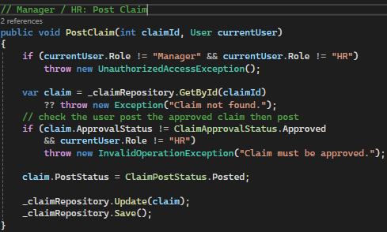
Part 2
In this case the SetApprovalStatus is link to the claim repository, when the coordinator or HR want to edit the status, first need to find if the claim exist and the check if they are authorized user. At this stage, the approval button will save the edit work change the value of month, years, hour, and hour rate though the _claimRepository.Update(claim); Then depend on which api been post, and change the status. Then save it in the database
The second case where about the post, which always check the role of user and get the claim id to edit the current claim. And if the user want post need to check fi the user were HR, if the user is HR then even though the claim were reject or still pending, the claim will reset as approval and post it. Or if the manager click on the post, the system will reject the post.

Slide 9
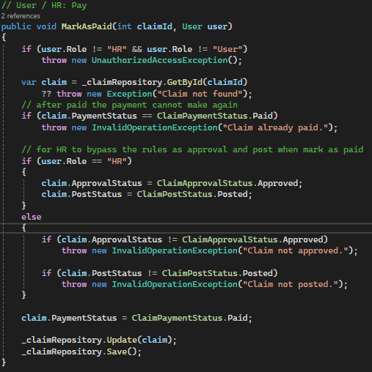
Part 3
While the user mark the payment, the payment will authentic the user role as user or HR, and try to search the claim if it is exist, then double check if the payment were been paid, this design can make sure the payment is not paying for twice or more in real case. Then same as the post, if the HR mark as paid, then the system will bypass all the status but set as approval, and post, which can save the time for HR by clicking buttons. After the status of mark as paid will save the database.

Slide 10
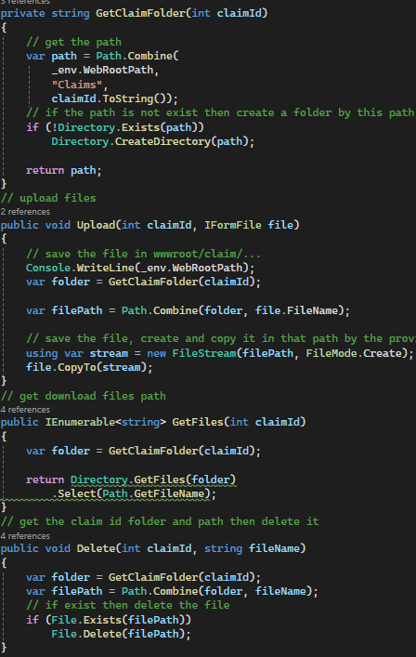
Part 4
The details is including the files path, which allows the HR and lecturer to upload files, and allows user to download the files that been upload.
The GetClaimfolder will get the path of the folder where files should be save, and the location should be in the wwwroot folder, the if statement of !Directory.exists(path) is find the folder for incase the folder did not exist then create the new folder by the claim id, which use the path as the initial path that search for.
The upload will save the file by the GetClaimFolder and copy the fils in the folder
GetFiles is using the GetClaimfolder path and save the selected files by names and download it if user needed by the API code
“return PhysicalFile(//Sends the file from disk
path, "application/octet-stream", file
);” that copy the files to the place user save as.
The delete where locate the files by the GetClaimfolder path and delete the selected files.
API action: the ClaimFileController where the controller handle the api of files issues, where upload, delete, download where just use the service logic and adding the input of values such as the claim id as example. Only the invoice call where calling the InvoiceService, but basically just save the claim details as pdf and use the Claim file controller’s upload, but with specific invoice pdf, and if any user edit the details, the invoice will be delete. When the manager or HR try to generate the invoice, the invoice api will stop them to generate the pdf more than a invoice file.

Slide 11
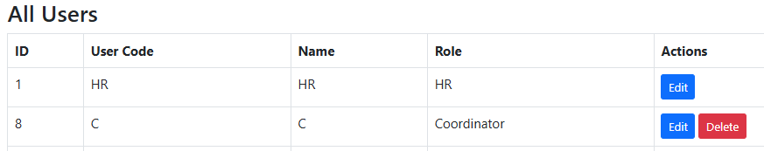
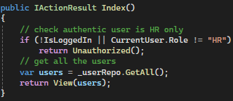
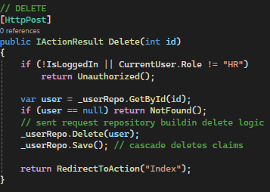
HR Index
Form explain: the container will list the user from the database, but only with login name, user real name and role, the actions box where contain the edit and delete button to allows HR to edit or delete the user, but delete is only work if the role user is not HR.
Code explain: the index where just check the user is HR and get the user data from the repository.
And the delete method where first ensure the user is exist then delete the user with repository. Then refresh the page.
The reason the HR controller is not using the API is because the the HR index where handing the user in database, there is no complex methods or rules limit by user’s role, can edit or not, and control who can view the table or data. therefore the design can be easier and simply design the controller where directly using the repository with logic in it.
While the user click on the edit button will direct to the edit page of user information.

Slide 12
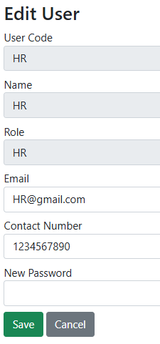
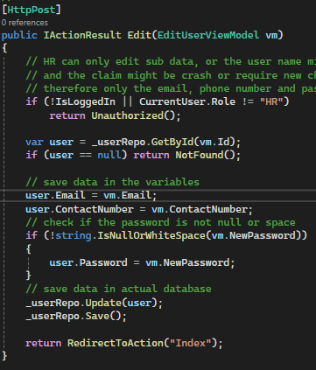
HR - Edit
Form :The edit user form has user code as the name to login with this account, and the Name is the real name of the person, where role to shows the session of role when login. The editable part of email, contract number and the password, HR can edit any part and password will be saved if the text box is not space or null. Then the cancel button will return to the index of the HR page.
Code: when the HR edit whether email, contact number or input the new password, first the system will check if the user is HR and get the selected user id , if the password has nothing entered then don’t save the change of password and process the update of user information or data. Then return to the index.

Slide 13
Reference:
OpenAI (2025) ChatGPT (GPT-5.2). Available at:
https://chat.openai.com
(Accessed: 9 January 2026).
ChatGPT (OpenAI) was used as a development support tool for brainstorming, guidance, debugging assistance, and example code generation.

